Slide 1

Datatypes in Java
Explore the diverse range of data types in the Java programming language, from primitive to reference types, and understand how they are used to store and manipulate information in your applications.
By AIML-C Group-2

Slide 2
Index
1
What are Datatypes?
2
Primitive Datatypes
3
Integer Datatypes
4
Floating Point Datatypes
5
Character Datatype
6
Boolean Datatype
7
Reference Datatypes
8
Wrapper Classes
9
Conclusion and Summary

Slide 3

What are Datatypes?
1
Fundamental Building Blocks
2
Efficient Memory Allocation
Datatypes define the kind of data that a variable can hold, such as numbers, text, or boolean values.
Different datatypes occupy different amounts of memory, allowing for optimized storage and performance in your code.
3
Type Safety
Datatypes enforce type checking, preventing errors and ensuring your program behaves as expected.

Slide 4
Primitive Datatypes
Numeric Types
Character Type
Boolean Type
Integers: byte, short, int, long
Represents a single character: char
Represents a true or false value: boolean
Floating-point: float, double

Slide 5
Java Datatype Examples
byte age = 17; // Integer Type: byte
int distance = 1000; // Integer Type: int
float temperature = 36.6f; // Floating-point Type: float
char grade = 'A'; // Character Type: char
boolean isPassed = true; // Boolean Type: boolean

Slide 6
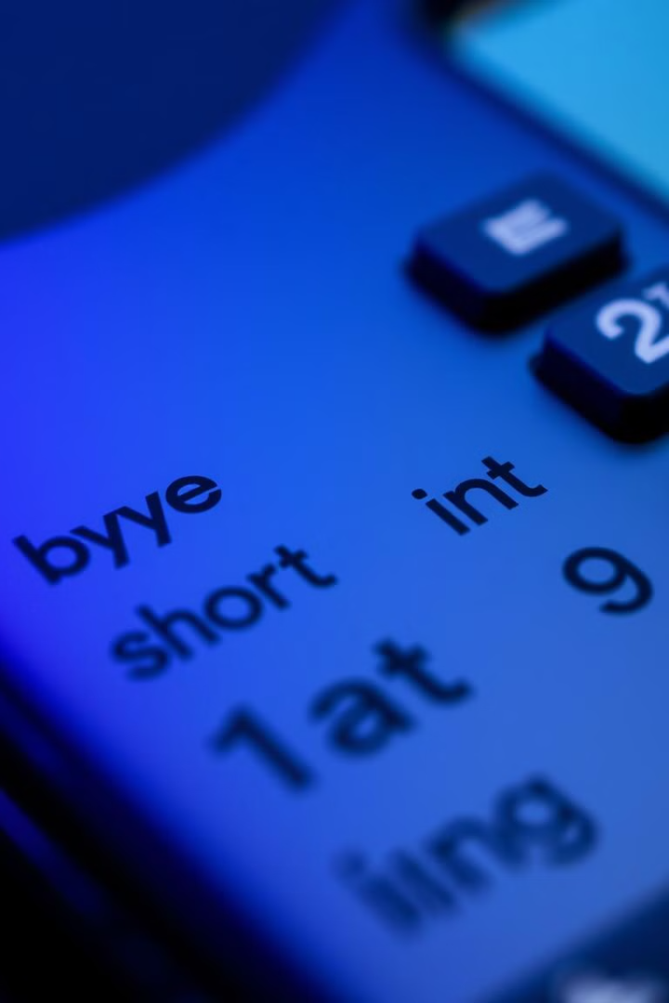
Integer Datatypes
1
byte
Smallest integer type, ranges from -128 to 127.
2
short
Ranges from -32,768 to 32,767.
3
int
Most common integer type, ranges from -2,147,483,648 to 2,147,483,647.
4
long
Largest integer type, ranges from -9,223,372,036,854,775,808 to 9,223,372,036,854,775,807.

Slide 7
Java Datatype Examples
byte age = 25; // Example of byte
short salary = 15000; // Example of short
int population = 1000000; // Example of int
long distanceToMoon = 384400000L; // Example of long

Slide 8
Floating Point Datatypes
float
double
Single-precision 32-bit floating-point type, suitable for storing decimal values with reduced precision.
Double-precision 64-bit floating-point type, suitable for storing decimal values with higher precision.

Slide 9
Java Datatype Examples
float temperature = 36.5f; // Example of float
double pi = 3.141592653589793; // Example of double

Slide 10

Character Datatype
char
Supports Diverse Characters
Represents a single Unicode character, using 16 bits of memory.
Allows for the storage and manipulation of a wide range of characters, from Latin scripts to emojis.

Slide 11
Java Datatype Examples
char letter = 'A'; // Example with a Latin letter
char symbol = '$'; // Example with a special symbol
char emoji = '\u263A'; // Example with a Unicode emoji

Slide 12

Boolean Datatype
1
true or false
2
Logical Operations
The boolean type can only hold two values: true or false.
Boolean values are commonly used in conditional statements and logical operations.

Slide 13
Java Datatype Examples
boolean isJavaFun = true; // Example of boolean (true value)
boolean isRaining = false; // Example of boolean (false value)

Slide 14
Reference Datatypes
Class Instances
Arrays and Strings
Reference types are used to create instances of classes, which can hold complex data and behaviors.
Arrays and Strings are also reference types, providing more advanced data structures.

Slide 15
Java Datatype Examples
String greeting = "Hello, World!"; // Example of a class instance (String) int[] numbers = {1, 2, 3, 4, 5}; // Example of an integer array String name = "John Doe"; // Example of a String reference type

Slide 16
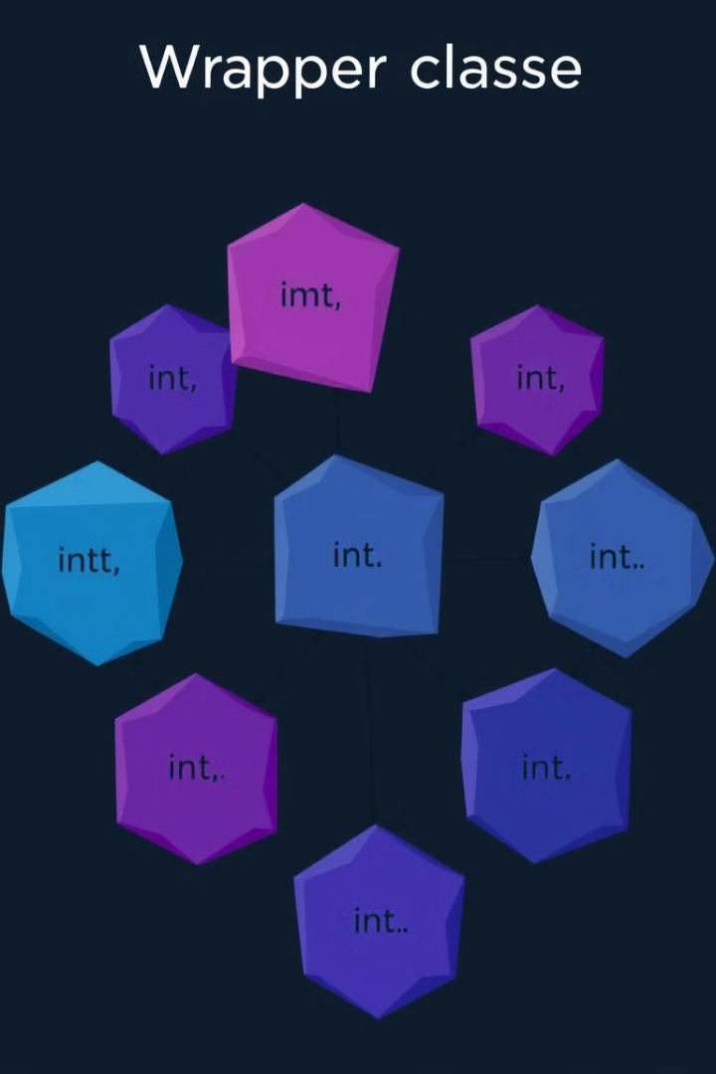


Wrapper Classes
Primitive to Object
Wrapper classes allow primitive datatypes to be treated as objects, enabling advanced functionality.
Object to Primitive
Wrapper classes also provide a way to convert objects back to their primitive counterparts.

Slide 17
Java Datatype Examples
Integer numObject = Integer.valueOf(100); // Boxing: int to Integer
int numPrimitive = numObject.intValue(); // Unboxing: Integer to int
Double temperature = 37.5; // Autoboxing: double to Double
double tempValue = temperature; // Auto-unboxing: Double to double

Slide 18
Major Data Types Used in Industry
1
Arrays
For Building Forms
2
Boolean
For Building Logic in a program.
3
int
For Data Entry.
4
long
For Mathematical Calculations

Slide 19
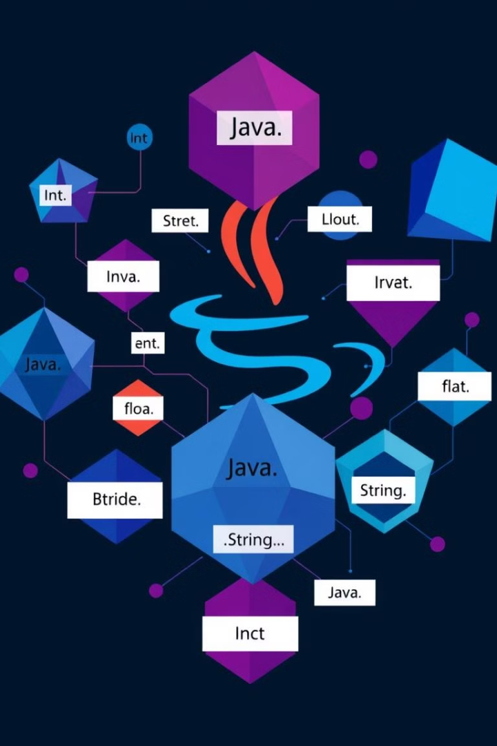
Conclusion and Summary
Mastering Datatypes
Careful Selection
Understanding the diverse range of Java datatypes is essential for writing robust and efficient code.
Choosing the appropriate datatype for your needs can improve performance, memory usage, and code readability.
Ongoing Learning
Continuously exploring the capabilities and nuances of Java datatypes will deepen your programming skills.

